Slide 1


Analysis of Purchase Order
Creation Delays & Their Causes
in Apparel Manufacturing Operations
R.M.R.G.I.S. Rathnayaka
S16725 | Faculty of Science, University of Colombo
Hela Clothing Private Limited

Slide 2

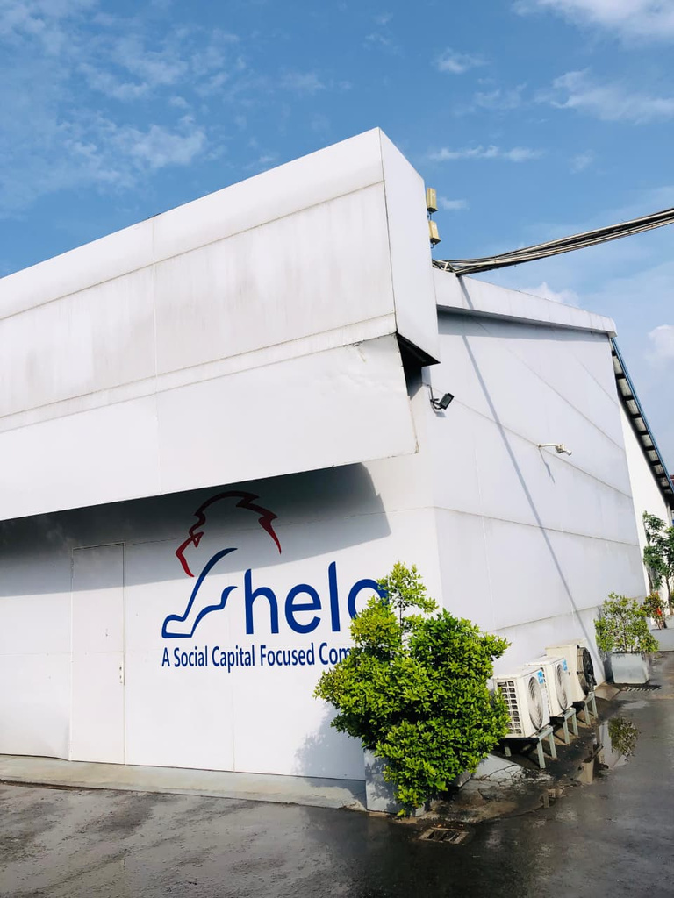

About Hela Clothing
One of Sri Lanka's leading apparel manufacturers
🏭Multiple manufacturing plants
🌍Global buyer network
📦Complex procurement operations
💻SAP-based ERP system

Slide 3
Project Overview
What is a Purchase Order (P.O.)?
An official document issued by a company to its suppliers that specifies materials needed, quantities, and delivery dates.
⚠️
The Problem
Delays in P.O. creation cause material shortages, production stoppages & increased costs
📐
Measurement
P.O. Delay = P.O. Created Date − Requirement Date
(Positive = late; Negative = early)
🔍
Study Focus
Analyse delay patterns across plants, customers & material types using SAP data

Slide 4


METHODOLOGY
SAP system exports:
P.O. Status, Pending P.O.
& Order Book Reports
Remove duplicates, handle
missing values, standardise
date formats in Excel
On-Time / Minor /
Moderate / Critical
(less than 10, 11-40, 41-80, 80+)
ANOVA (plant & customer)
Chi-Square test
(delay vs. comment)
Power BI dashboards
for operational
pattern discovery
1
2
3
4
5
Data Collection
Data Cleaning
Delay Categorisation
Statistical Analysis
Visualisation

Slide 5

Key Findings
42K
~5,500
72 days
129 days
On-Time P.O.s
Delayed P.O.s
Peak avg. delay
(Jan 2026)
Highest customer
avg. delay (CKM)
Statistical Test Results:
ANOVA (Plant-wise): F = 606.6, p < 0.05 → Significant differences in delay across Plants.
ANOVA (Customer-wise): F = 1064.5, p < 0.05 → Significant differences across Customers.
Chi-Square Test: χ² = 49308, p < 0.05 → Delay category is associated with reason category
Top delay reason: System/Verification Issues (30%) followed by Delivery/Approval issues (22%)

Slide 6
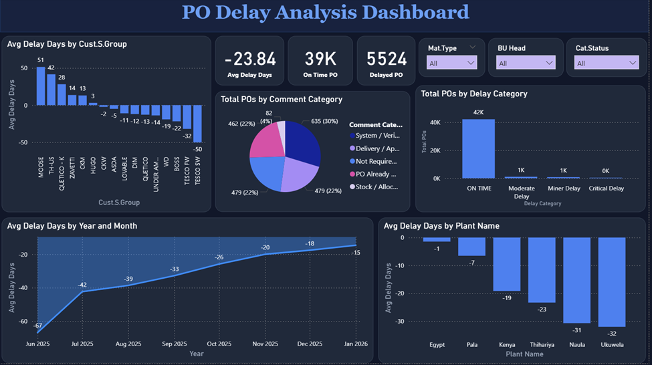

Visualisation

Slide 7
Recommendations
Require staff to record concise business reasons for every P.O. delay in SAP to enable accurate root-cause analysis
Strengthen coordination between Planning, Procurement & Production teams to ensure timely P.O. initiation.
Implement automated Power BI dashboards to continuously monitor procurement performance and flag emerging delays.
Mandatory Delay Documentation
Improve Cross-Team Communication
Real-Time Monitoring Dashboard
Share best practices from high-performing plants across all locations to reduce inter-plant performance variation.
Conduct periodic operational reviews using data analytics to detect inefficiencies before they impact production.
Standardise Plant Procedures
Routine Data-Driven Reviews

Slide 8

New Knowledge Gained
SAP ERP in Procurement
Navigating live SAP modules for P.O. status reports, order books, and pending reports in a real manufacturing environment.
Supply Chain Dynamics
From Classroom
to Operations
Understanding how delays at one point (P.O. creation) cascade through sourcing, production planning, inventory & shipment scheduling.
Statistical Hypothesis Testing
Applying ANOVA and Chi-Square tests to real operational data to derive statistically grounded conclusions.
Practical exposure to real-world
procurement operations that
textbooks cannot fully replicate.
Business Comment Analysis
Learned to manually code and categorise free-text operational data, a skill essential in qualitative-to-quantitative research.

Slide 9

Skills Acquired During Training
Technical Skills
Analytical Skills
Professional Skills
SAP ERP navigation & report extraction.
SPSS: ANOVA, Chi-Square analysis
Power BI: dashboard design & DAX
Data cleaning (duplicates, date formats, missing values)
Quantitative research design
Operational data interpretation
Root-cause analysis via comment coding
Pattern identification in large datasets
Cross-departmental communication
Working within corporate timelines
Report writing for industry context
Presenting findings to senior staff

Slide 10
Attitudinal Changes & Personal Growth
Before Internship
After Internship
✗ Viewed data as academic exercises
✓ Every data point represents a real operational decision
→
✗ Saw statistics as theoretical tools
✓ Statistics are essential instruments for evidence-based management
→
✗ Assumed processes follow textbook models
✓ Real operations are messy; adaptation and critical thinking are crucial
→
✗ Worked in isolation
✓ Collaboration & communication across teams is key to operational success
→

Slide 11
Challenges Faced & How I Overcame Them
💬 Missing business comments for many P.O.s
✓ Restricted delay-cause analysis to the subset with comments; emailed teams to collect pending reasons
→
🗃️ Inconsistent & duplicate SAP data
✓ Developed a systematic cleaning process: removed duplicates by P.O. number, standardised date formats
→
📑 Free-text comments with no standard format
✓ Manually reviewed & coded each comment into 5 operational categories using iterative grouping
→
📅 Limited dataset timespan (6 months)
✓ Focused on pattern identification within available data; acknowledged as a limitation; recommended longitudinal study
→

Slide 12
Personal Reflection: Overall Growth
🎓 Academic → Industry
🧠 Mindset Shift
🌟 Professional Identity
Applied University-learned statistics (ANOVA, Chi-Square) to solve a real business problem.
Learned that academic rigour enhances , not replaces practical judgment.
Developed patience and attention to detail during data cleaning.
Learned to work within organisational constraints and adapt analysis to available data
Grew more comfortable presenting data-backed arguments to experienced professionals.
Discovered a genuine interest in data analytics and operational research.
Understood the value of clear documentation in collaborative environments.
Built confidence in handling end-to-end analytical projects independently.

Slide 13

Conclusion
📌P.O. delays, though small in aggregate, reveal significant inefficiencies at the plant and customer level
📌Data-driven tools (SPSS + Power BI) are powerful for uncovering operational patterns invisible to the naked eye
📌The internship transformed theoretical knowledge into practical, industry-relevant analytical skills
📌Documentation discipline, cross-team communication, and standardisation are the keys to reducing P.O. delays
📌This experience has shaped my aspiration to pursue a career in data analytics and operational management

Slide 14
Thank You!

